Slide 1





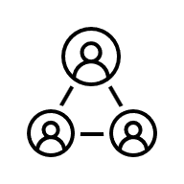





Call Centre Application for Healthcare Client
Scope
Out of Scope
Member Portal
Provider Portal
Sign up and Login
Submit Case
Sign up and Login
Submit Case
Create Case
View/Check Status
Create Case
View/Check Status
Future Scope
Azure Active Directory
D365 Customer Engagement
Azure Platform
External System
D365 Customer Service
Omnichannel
System Admin/ Super User
Centralized Customer Profile
Email Template
Apple Message for Business
Centralized Case Management
Email Notification
Co-Pilot studio(PVA)
Case Worker for Dream jet
Business Process Flow
Live Chat
Azure Function
KB Article
Case Worker for Connect Air
Queue Management
Agent Workspace
Ticketing System
Dream jet Manager
Routing Rule
Connect Air Manager
SLA (Service Level Agreement)
Channels
Security
Audit Trial
Dashboard
Activities
Templates
Workflows
Portal
Email
Azure APIM
Document
File Access
MS Exchange
Azure Monitor

